Slide 1


Birthdays in May
Craig Allman (Venture)
Kendra Anthony (Jackson)
Nicholas Coleman (Venture)
Joe DiGiglio (Venture)
Matt Elliott (Jackson)
Jordan Ernst (Venture)
Kim Hale (Jackson)
Abubakr Hanek (Venture)
Thomas LaBeau (Venture)
Telisa Langford (Venture)
Kailen McKay (Jackson)
Kahla Sardo (Venture)
Dayna Schultz (Jackson)
Mike Takacs (Venture)
Hong Wang (Venture)

Slide 2

Anniversaries in May
5 Years
Eric Castle (Jackson)
4 Years
Kelly Paniwozik (Jackson)
3 Years
Mike Buettner (Jackson)
Joe DiGiglio (Venture)
1 Year
Nicholas Coleman (Venture)

Slide 3
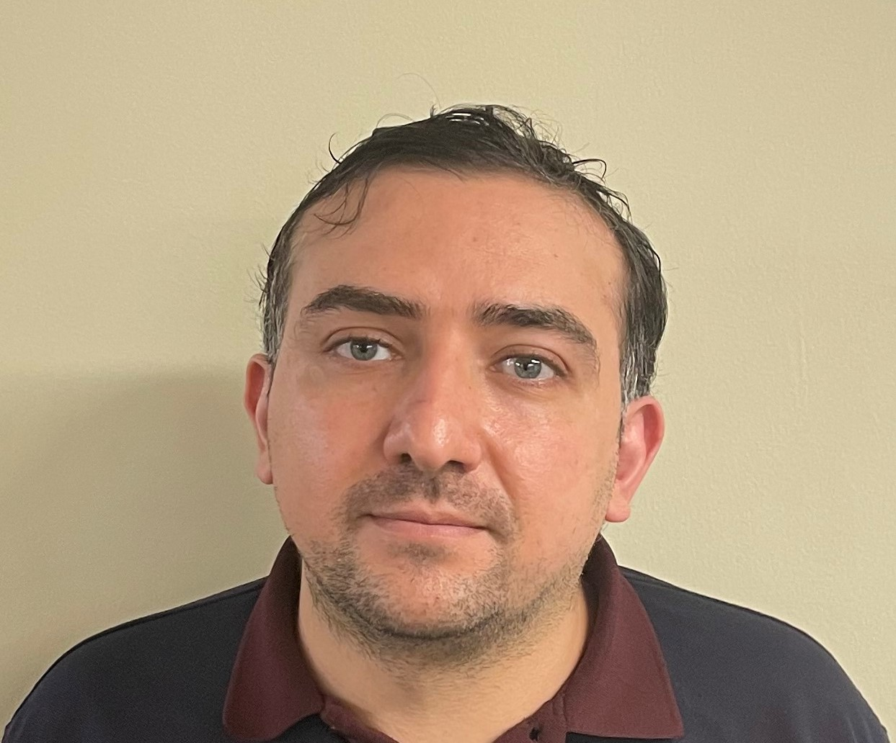
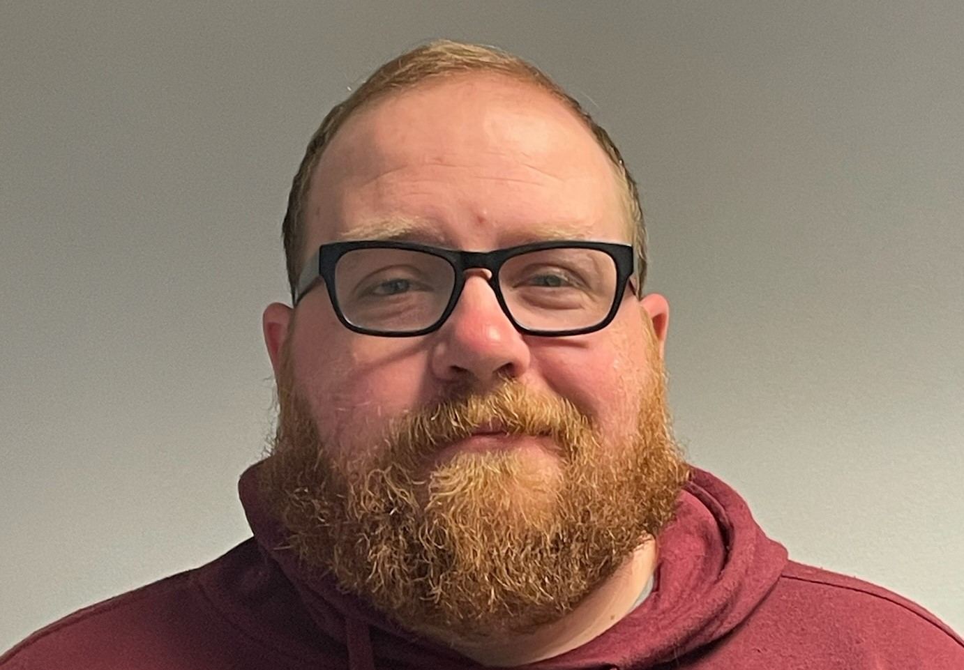

Recent New Hires
Mohammad Abouzahr Jackson Production
Brad Forgie
Venture Technician

Slide 4
Current Open Positions
Salary
Applications Engineer (Jackson)
Electrical Engineer (Jackson)
Research Engineer (Venture)
Senior Mechanical Engineer (Jackson)
Senior Research Scientist (Venture)
Staff Accountant (Jackson)
Systems Engineer (Jackson)
Hourly
Quality Tech (Venture)
Quality Engineering Intern (Jackson)
Mechanical Engineering Intern (Jackson)
Electrical Engineering Intern (Jackson)

